Slide 1
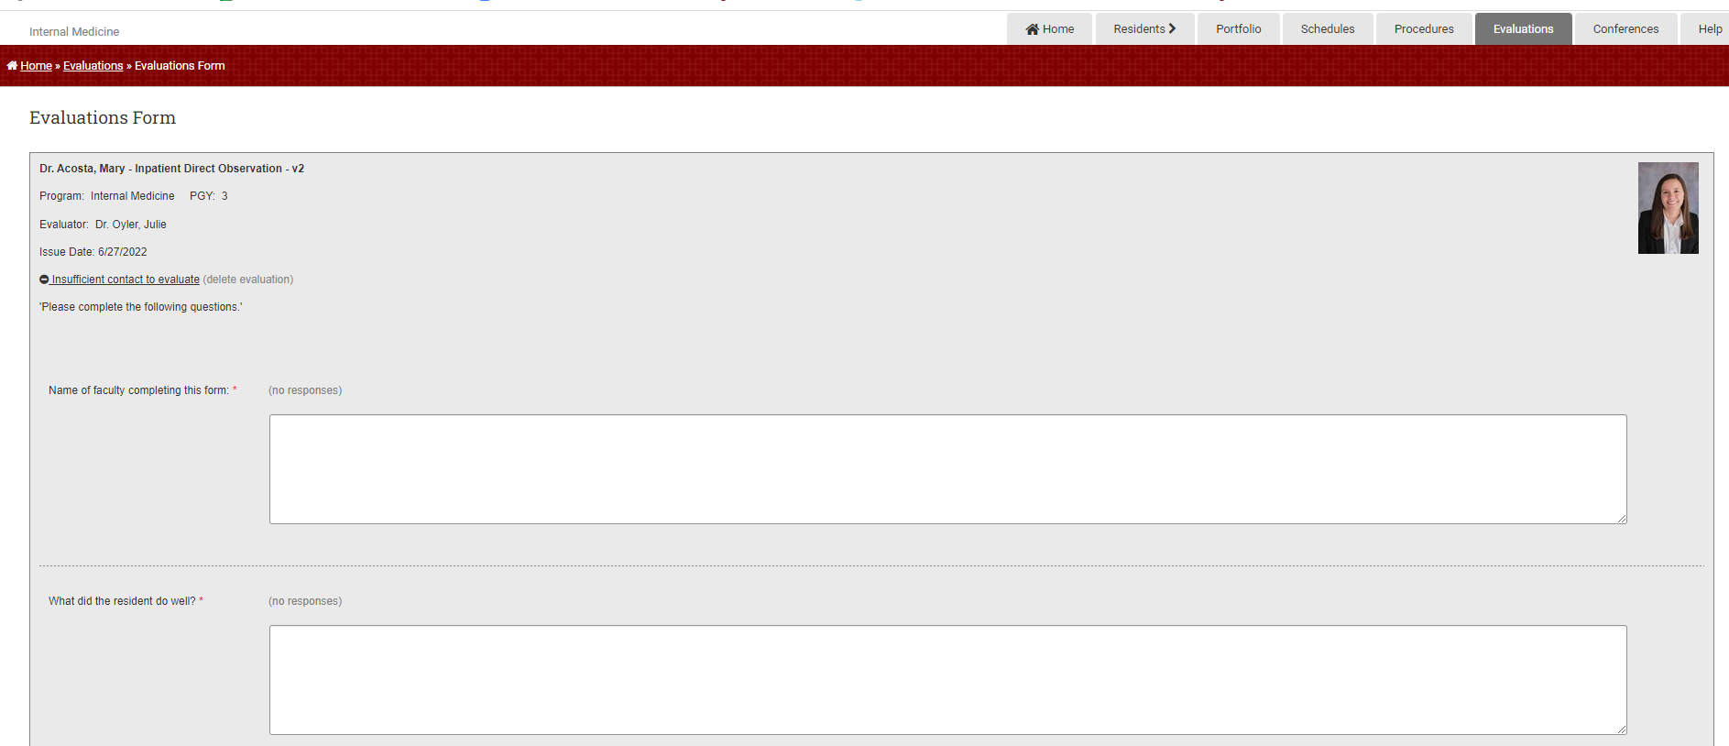
Firm Faculty Coaching Topic PGY1 #1
Explaining clinical plan to patient (Direct observation) – Med Hub Computer app
After resident discusses plan with faculty in the resident work room, attending returns to the patient room to watch the resident explain the clinical plan to the patient.
Use the MedHub app on a COMPUTER to complete the Direct Observation evaluation. (www.Uchicago.MedHub.com). Login using CNETiD. At the TOP of screen, chose EVALUATIONS. At the TOP of Evaluations Screen, chose INITIATE PERFORMANCE EVALUATION OF RESIDENT
Chose resident and INPATIENT DIRECT OBSERVATION,
Complete evaluation and SUBMIT

Slide 2
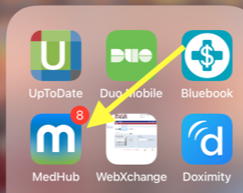
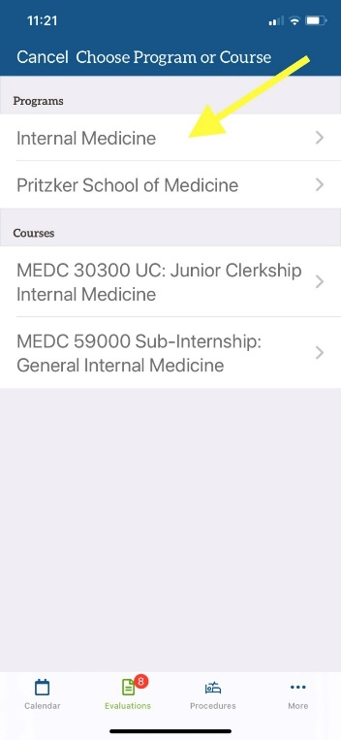
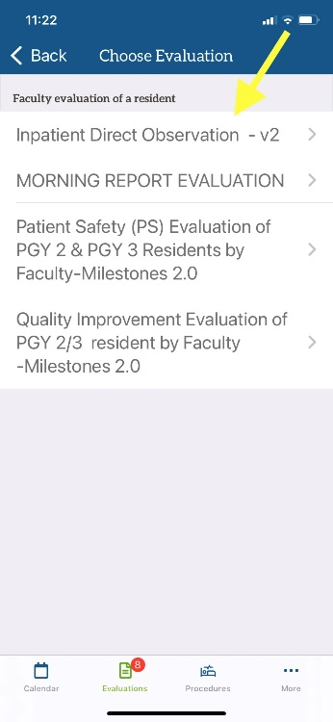
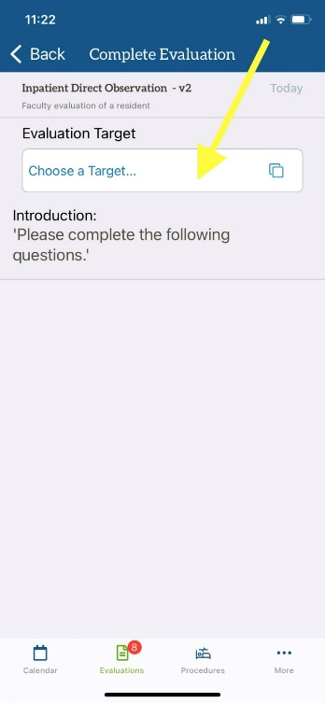
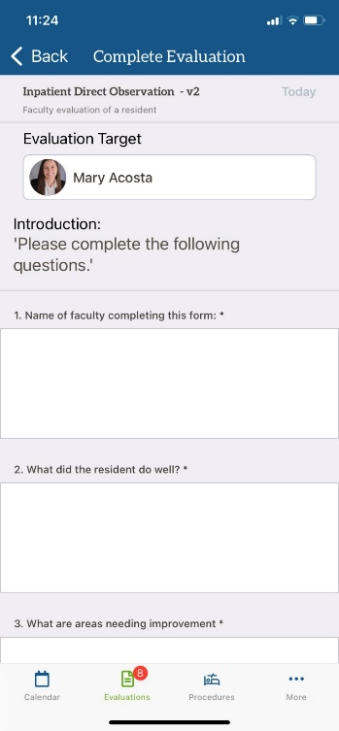
Firm Faculty Coaching Topic PGY1 #1
Explaining clinical plan to patient (Direct observation) – Med Hub phone app
After resident discusses plan with faculty in the resident work room, attending returns to the patient room to watch the resident explain the clinical plan to the patient.
Use the MedHub app on a phone or computer to complete the Direct Observation evaluation.
4. At the TOP of Evaluations Screen, chose PENCIL (create evaluation) icon.
5. Chose INTERNAL MEDICNE.
6. Chose INPATIENT DIRECT OBSERVATION
7. Chose TARGET resident
8. Complete evaluation and hit SUBMIT
5.
6.
7.
8.
3. At the BOTTOM of screen, chose EVALUATIONS.

