Slide 1
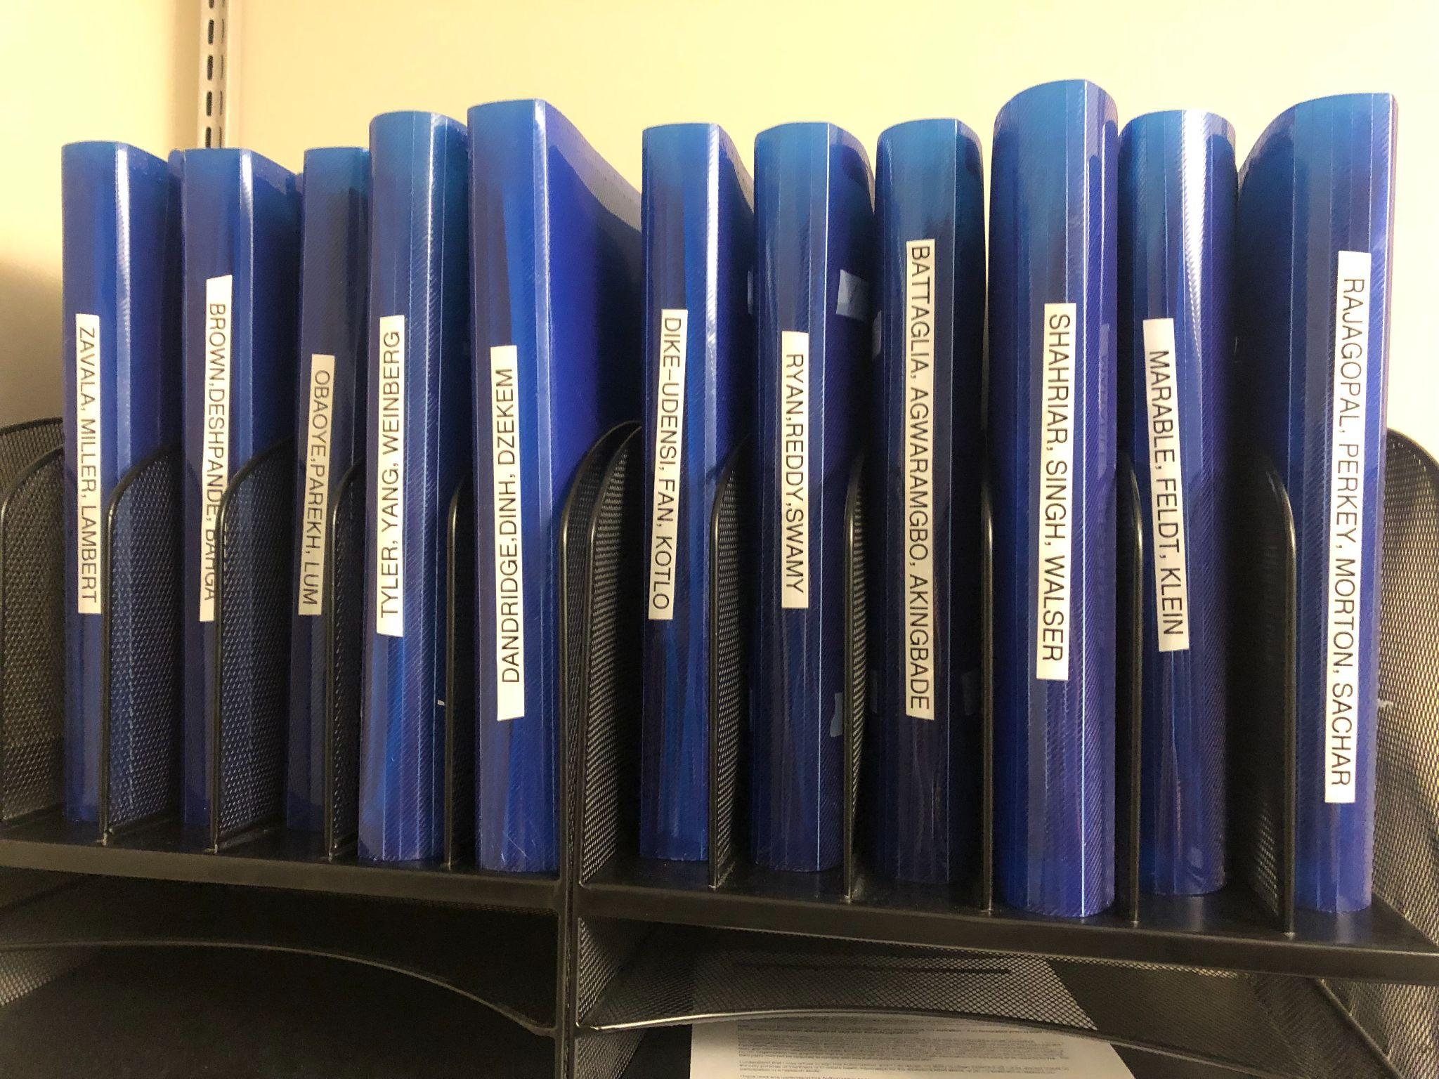
Firm Faculty Coaching Topic PGY1 #6
What is the PCG trio folder?
Each trio has a PCG trio folder; all physical paperwork will be placed in this folder by your LNP or RN
Given you are not always in clinic, it is important to come up with a trio plan!
You + trio partners will sign up for times to cover the PCG folder
Typically, resident on +2 block covers paperwork for their trio
For the person covering the PCG folder, paperwork should be completed at least once per week
Common paperwork requests:
Home Health Orders
FMLA (Family and Medical Leave Act)/HHS/Disability forms
Call or schedule an appointment for FMLA to be completed
Prior authorization: LPN can help start process with pharmacy
Most paperwork should be completed within 72 hours
For urgent paperwork, Firm RN should contact the covering MD
After completing paperwork:
Give this paperwork directly to your LPN or RN
Alternatively, you can place completed forms in “paperwork to be faxed”

