Slide 1
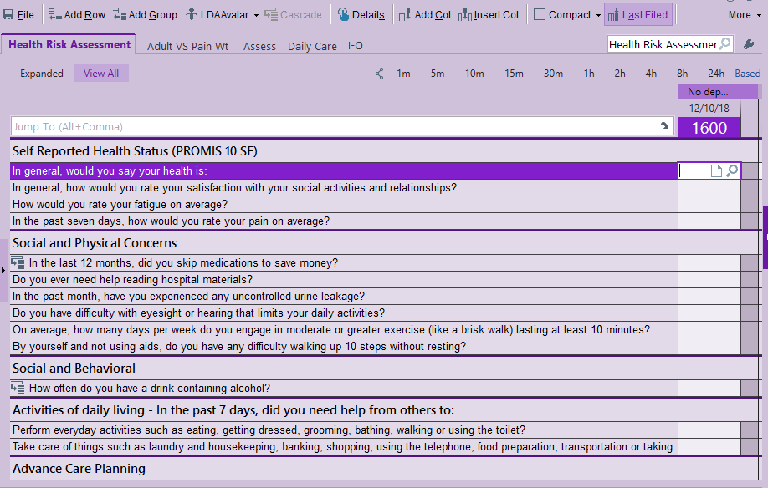
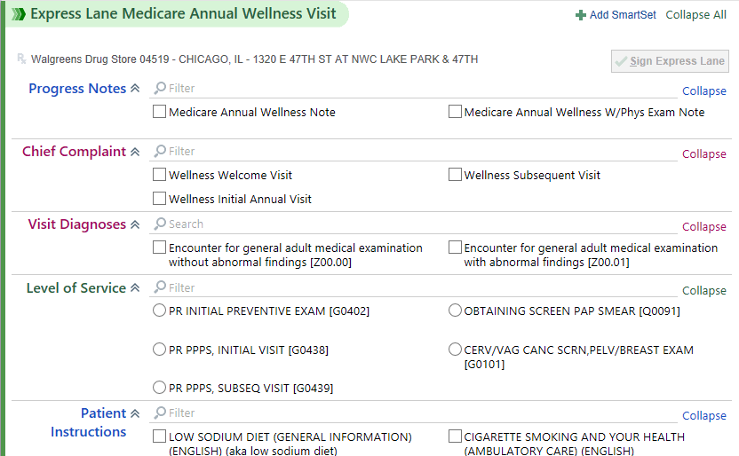
Firm Faculty Coaching Topic PGY2 #8
Annual Wellness Visit
AWV steps:
Verify >365 days since last AWV
Update Medical History, Meds, Care Team
Address Best Practice Alerts
Perform Medicare Health Risk Assessment (MA can do this if requested). Find in Flowsheets.
Complete Medicare AWV Smart Set
Associate Chronic Medical Problems as Visit Dx
Finalize note and document counseling.
a. Find “Health Risk Assessment” in Flowsheets (MA can complete except Advance Care Planning and Mini Cog)
b. Find Annual Wellness Visit SmartSet. Write note, use Wellness visit as Chief Complaint, Visit Diagnosis and Level of Service. Add Patient Instructions.

Slide 2
Firm Faculty Coaching Topic PGY2 #8
Advance Care Planning (ACP)
Hover over Code Status in Patient Header. Review Advance Care (ACP) planning information. (a)
Click on Code Status to:
- Enter Health Care Medical Decision Maker (b)
- Print POLST and Healthcare Power of Attorney (HCPOA) forms (c)
- Create Advance Care planning note for chart (d)
- Review ACP documents (e)
HCPOA form can be uploaded by handing to nurse, printing labels and placing in box in nursing room. MA ok to witness HCPOA documents
b. View/change Decision Maker
c. View/print ACP forms
a. Hover over Code Status in Patient header
d. Create ACP note to document ACP discussion with patient
e. View completed patient ACP documents

